Slide 1

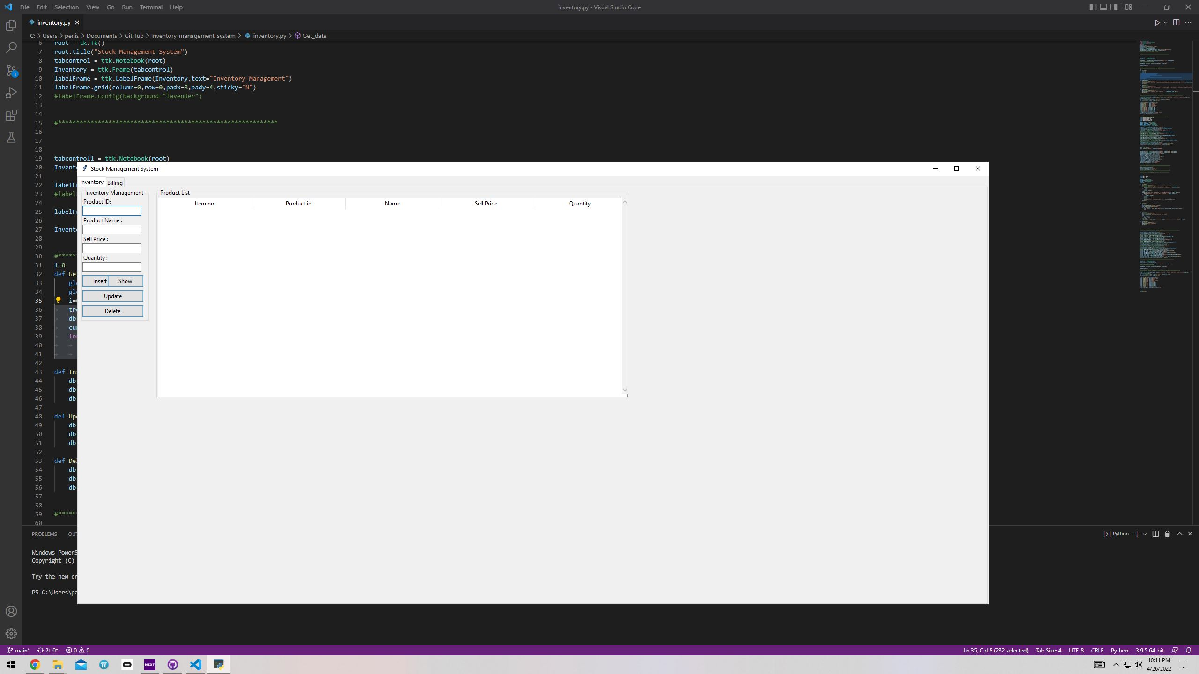
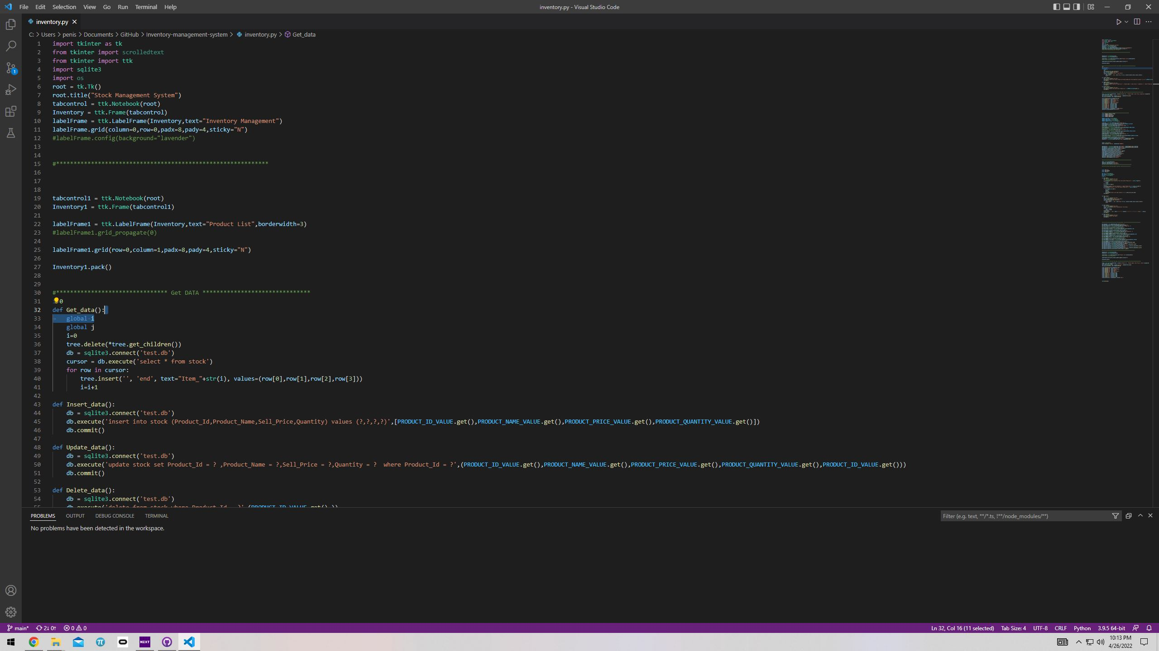
Inventory Management System
Coder: Santonu Ghosh
I am coding an app that can monitor and update the product inventory of any retail store in real time.

